Slide 1


Green Pace
Security Policy Presentation
Developer: Dustin Haugh

Slide 2

OVERVIEW: DEFENSE IN DEPTH
[Introduce your security policy. Explain why it was needed and how it will be used to support the defense-in-depth best practice.]

Slide 3
THREATS MATRIX
PROBABILITY | SEVERITY | Severity
 | LOW HARM | MEDIUM HARM | HIGH HARM
LIKELY |  |  | STD-001-CPP STD-002-CPP STD-003-CPP STD-004-CPP STD-005-CPP STD-009-CPP
PROBABLE | STD-007-CPP STD-010-CPP |  | STD-004-CPP
UNLIKELY | STD-006-CLG | STD-008-CPP

Slide 4
10 PRINCIPLES
Validate Input Data
STD-001-CPP
STD-002-CPP
STD-004-CPP
Heed Compiler Warnings
STD-003-CPP
STD-010-CPP
Architect and Design for Security Policies
STD-009-CPP
Keep It Simple
STD-008-CPP
Default Deny
STD-005-CPP
Adhere to the Principle of Least Privilege
STD-005-CPP
Sanitize Data Sent to Other Systems
STD-004-CPP
STD-010-CPP
Practice Defense in Depth
STD-001-CPP
STD-002-CPP
STD-004-CPP
Use Effective Quality Assurance Techniques
STD-004-CPP
STD-010-CPP
Adopt a Secure Coding Standard
STD-004-CPP
STD-006-CLG

Slide 5
CODING STANDARDS
Rule | Severity | Likelihood | Remediation Cost | Priority | Level
STD-003-CPP | High | Likely | Medium | P18 | L1
STD-004-CPP | High | Likely | Medium | P18 | L1
STD-005-CPP | High | Likely | Medium | P18 | L1
STD-001-CPP | High | Likely | High | P 9 | L2
STD-002-CPP | High | Likely | High | P9 | L2
STD-009-CPP | High | Likely | High | P9 | L2
STD-010-CLG | Low | Probable | Low | P6 | L2
STD-006-CPP | Low | Unlikely | Medium | P2 | L3
STD-007-CPP | Low | Probable | Medium | P4 | L3
STD-008-CPP | Medium | Unlikely | Medium | P4 | L3

Slide 6
ENCRYPTION POLICIES
Encryption in rest: Protects stored data.
AES Encryption of data stored on hard drives, phones, computers, cloud assets, etc.
Encryption at flight: Protecting data that is moving.
AES Encryption using keys with data moves from devices within a network or moving outside of a network.
Encryption in use: Protects data that is created, edited, or otherwise defined as in-use.
Encrypting and Decrypting data while opening and saving data in use.

Slide 7
TRIPLE-A POLICIES
Authentication
The act of confirming one’s identity.
Two-factor authentication might be an added security policy to ensure authentication of the user.
Authorization
Specifies the access rights and privileges of a user and are an important part of information and computer security.
This goes along with the Default Deny principle,
Accounting
Accounting of user actions that can be a good way to look for suspicious use of the system.

Slide 8
Unit Testing
Unit testing is an essential way to look for coding errors that might cause vulnerabilities or undefined behavior in an application. Google testing (gtest) is one method we can use to perform unit tests.
Use Google Test for C++ in Visual Studio:
https://learn.microsoft.com/en-us/visualstudio/test/how-to-use-google-test-for-cpp?view=vs-2022

Slide 9
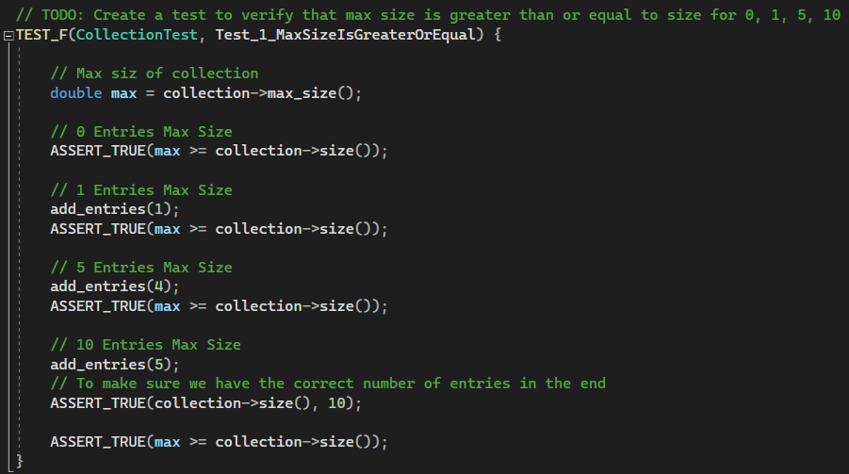
GUnit Test: MaxSizeIsGreaterOrEqual

Slide 10
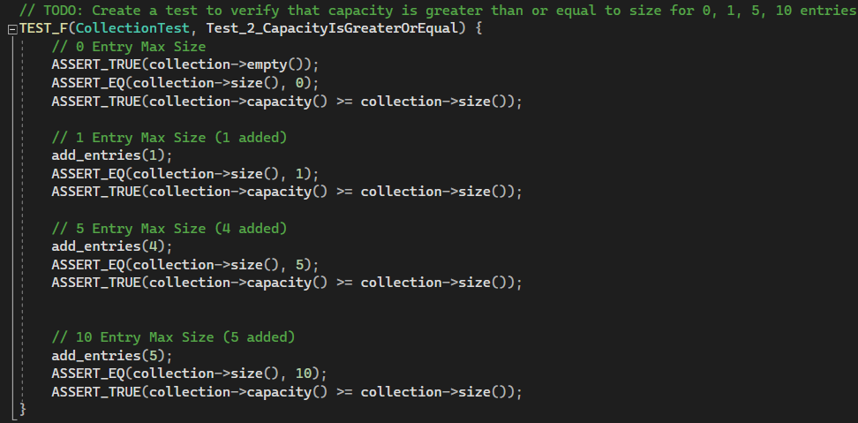
GUnit Test: CapacityIsGreatorOrEqual

Slide 11
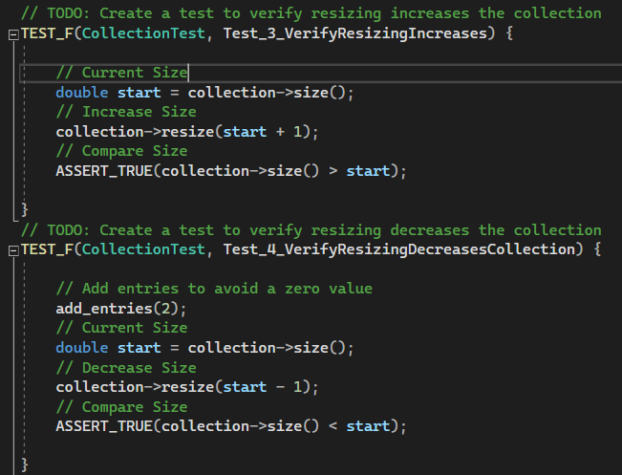
GUnit Tests: VerifyResizingIncrease and VerifyResizingDecreaseCollection

Slide 12

AUTOMATION SUMMARY

Slide 13
TOOLS
The DevSecOps pipeline is essentially an approach to software development that takes security into consideration from the beginning.
CppCheck is a tool that we can use to test for vulnerabilities during the build phase.
https://cppcheck.sourceforge.io/

Slide 14
RISKS AND BENEFITS
Risk of waiting:
Expensive, time-consuming repairs
Liability
Financial cost
Loss of reputation
Benefits of early action:
Mitigate possible damage
Add layers of security to prevent risk
Reduce liability
Increase reputation
Find possible risks before they are taken advantage of by someone creative

Slide 15
RECOMMENDATIONS
Possible Gaps in Security Policy:
It is possible to have a missing security policy. Every project is different, and policies can vary depending on the project. It can be good to search for updated security policies or talk to a security expert.
We should look for changes in security policies published annually.

Slide 16
CONCLUSIONS
Adopting best practices and secure coding standards are fundamental to software development. Utilizing Defense in Depth strategy and taking security into consideration from the beginning of development is a strong strategy for successfully safeguarding Green Pace.

Slide 17
REFERENCES
References:
Gillis, A. S. (2023). authentication, authorization and accounting (AAA). Security. https://www.techtarget.com/searchsecurity/definition/authentication-authorization-and-accounting
Secure Coding in C++11 and C++14. (2016, September 26). SEI Blog. https://insights.sei.cmu.edu/blog/secure-coding-in-c11-and-c14/
What is Defense in Depth? Defined and Explained | Fortinet. (n.d.). Fortinet. https://www.fortinet.com/resources/cyberglossary/defense-in-depth#:~:text=Defense%20in%20depth%20is%20a,are%20stopped%20along%20the%20way.

